Slide 1



Rockbuster Stealth
Data Analysis

Slide 2
Overview
Rockbuster Stealth LLC is a movie rental company that used to have stores around the world. Facing stiff competition from streaming services such as Netflix and Amazon Prime, the Rockbuster Stealth management team is planning to use its existing movie licenses to launch an online video rental service in order to stay competitive.
Objective
Helping Rockbuster Stealth's Business Intelligence (BI) department with the launch strategy for the new online video service

Slide 3
Key Questions
Which movies contributed the most/least to revenue gain? Which movie genres contributed the most to revenue gain?
What was the average rental duration for all videos?
Which countries are Rockbuster customers based in?
Where are customers with a high lifetime value based?
Do sales figures vary between geographic regions?

Slide 4
Most and Least Revenue Movies
The top 3 movies with the highest revenue are Telegraph Voyage, Zorro Ark and Wife Turn.
The lowest 3 movies with the lowest revenue are Duffel Apocalypse, Oklahoma Jumanji and Texas Watch.

Slide 5
Total Revenue by movie genre
The top 3 highest earning movie genres are Sports, Sci-Fi and Animation.

Slide 6
Average RENTAL DURATION
The average rental duration for all movies ranged from 4-6 days with the highest rental duration genres being Thriller, Travel and Music.

Slide 7
Movie Overview
Rental Duration
Min | 3 Days
Max | 7 Days
Avg | 5 Days
Rental Rate
Min | $0.99
Max | $4.99
Avg | $2.98
Movie Length
Min | 46 mins
Max | 185 mins
Avg | 115 mins
Replacement Cost
Min | $9.99
Max | $29.99
Avg | $19.98

Slide 8
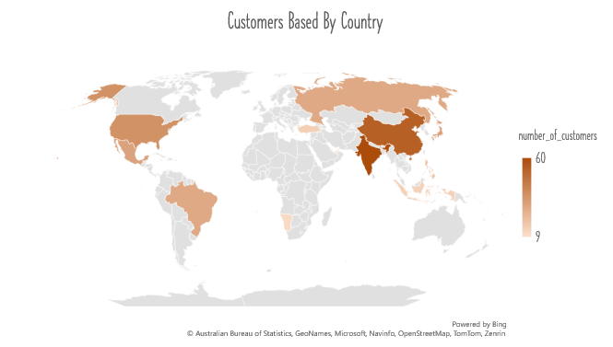
Customers Based By Country
The map shows the number of Rockbuster customers per country and India, China, and the United States are the top 3 countries who have the highest number of customer’s and are the highest paying customers.
Country | Number of Customers
India | 60
China | 53
United States | 36
Japan | 31
Mexico | 30
Brazil | 28
Russian Federation | 28
Philippines | 20
Turkey | 15
Indonesia | 14

Slide 9
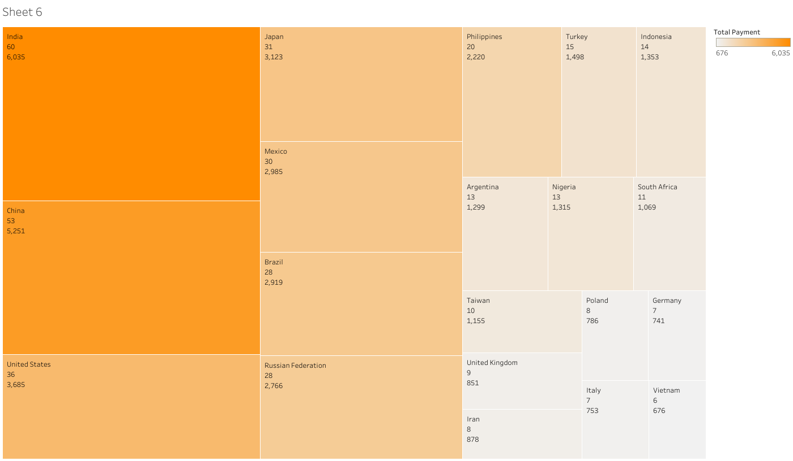
High Lifetime Customers
High Lifetime Customers by Regions
The top 3 countries with the highest total revenue and customers include:
India
China
United States
The bottom 3 countries with the lowest total revenue and customers include:
Germany
Italy
Vietnam

Slide 10
Geographic region sales
The following bar chart below shows the total revenue of Rockbuster sales by geographic region. Asia has the highest number of sales, followed by Europe and South America.

Slide 11
Summary
The top 5 most popular genres: Sports, Sci-Fi, Animation, Drama, Comedy
The top 3 most profitable regions: Asia, North America, South America
The top 5 countries with highest customer counts and highest customer lifetime value: India, China, United States, Japan, Mexico

Slide 12
Recommendations
Focusing on marketing in Asia, the most profitable region, followed by the other named regions
Focusing on marketing in high revenue genres, such as Sports, Sci-Fi, Animation, Drama, Comedy
Rewarding loyal customers by offering them discounts on rentals or special subscription plans
Extend rental duration at a reduced cost
Eliminate low revenue movie titles to maximize high revenue movie titles

Slide 13


Thank you
Gurpreet Kaur
gkzildar@gmail.com

